Slide 1


Git Collaborations and Workflows
ECOL 8030
Git: Part II
24 April 2017

Slide 2
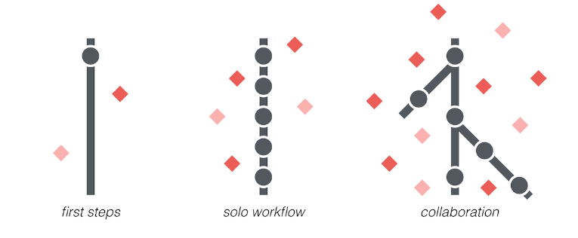
Moving from solo workflow to collaboration
When working with multiple collaborators, may not want everyone’s changes going directly to the master
Create separate ‘feature branches’ to focus on single

Slide 3
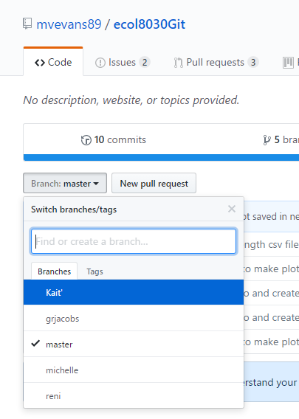
Creating a Branch
Work on your own branch
Merge back into the master when you’re ready
Can’t make a branch directly through RStudio
On GitHub, under Code tab, click on “Branch: master”
Select an existing branch or type to create a new one

Slide 4
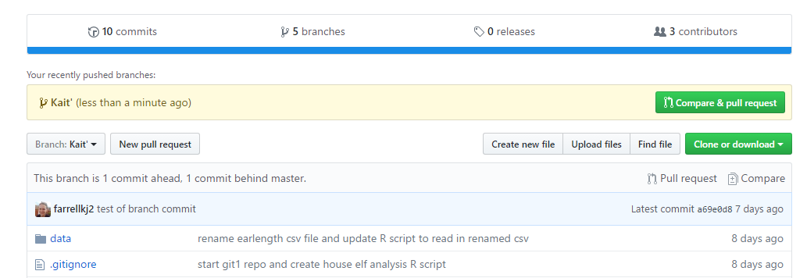
Working on your branch
Pull → modify → Commit → Push
This pulls and pushes just from your branch
On GitHub, you can compare your branch to master, and create pull request

Slide 5
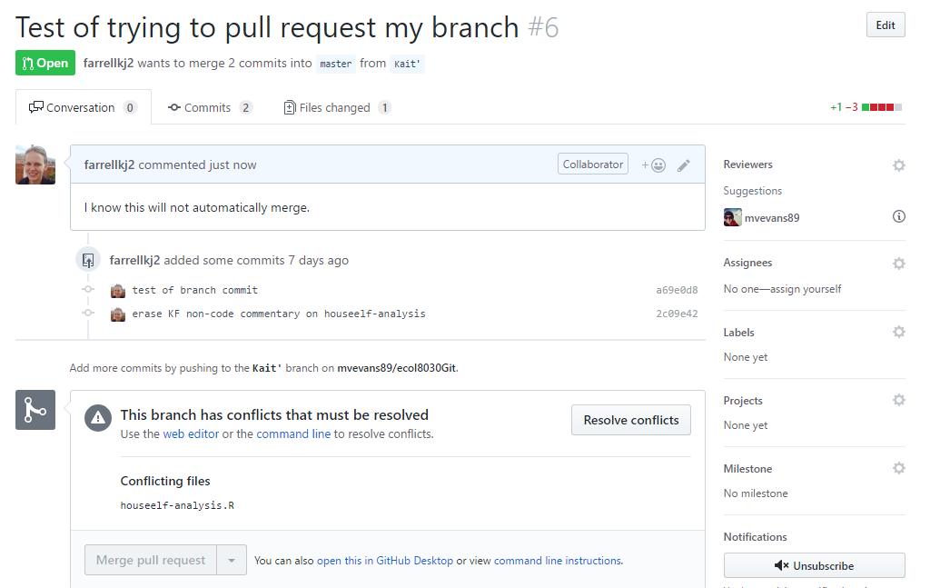
Oh no, my pull request failed!

Slide 6
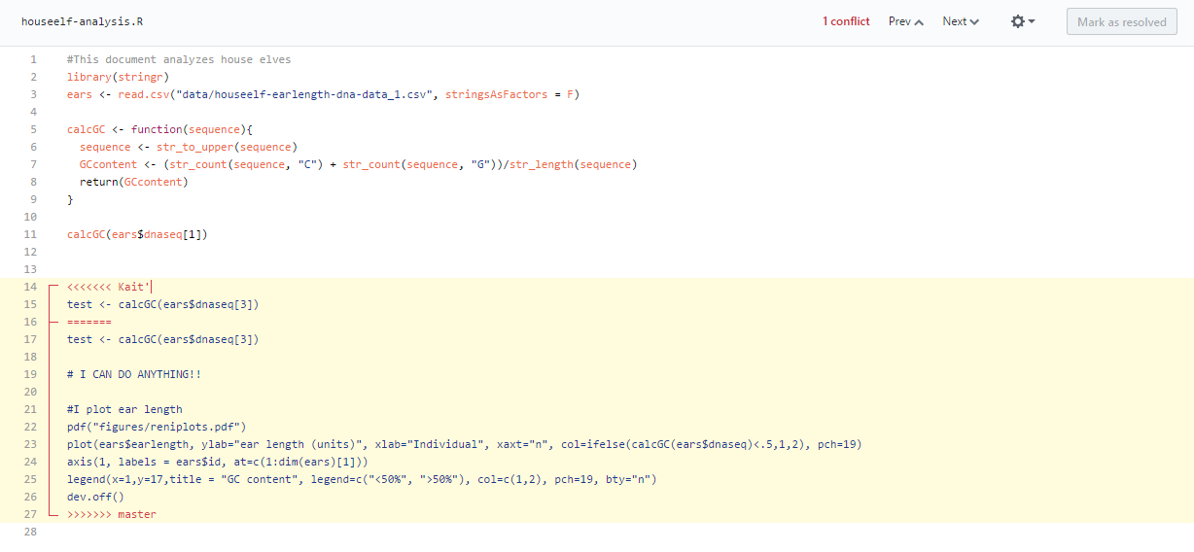
Conflict resolution… in GitHub
Highlighted area shows where code in my branch differs from what is currently committed to the master

Slide 7
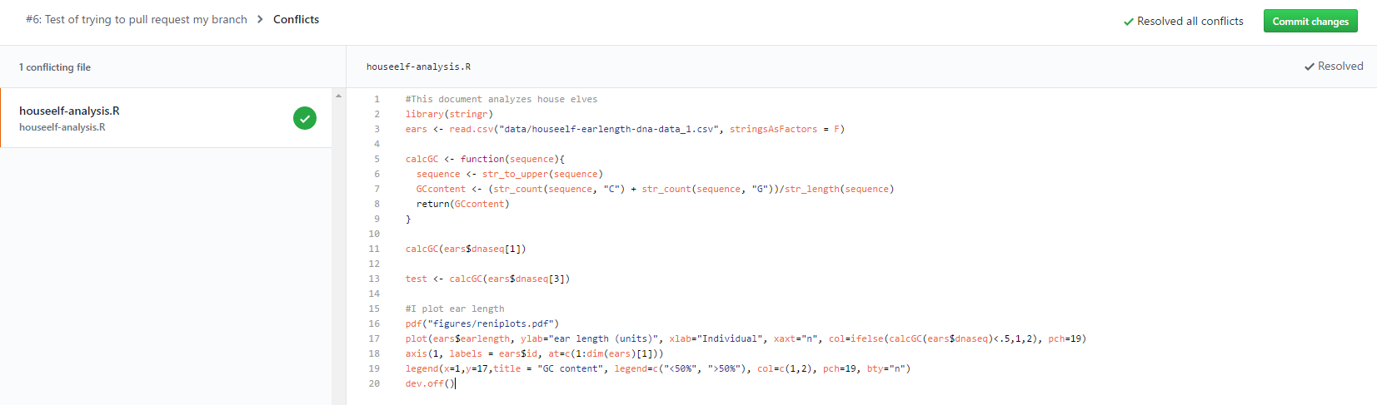
Fix and commit
You have to manually resolve the issues, but once that’s done, click Mark as Resolved and commit your changes

Slide 8
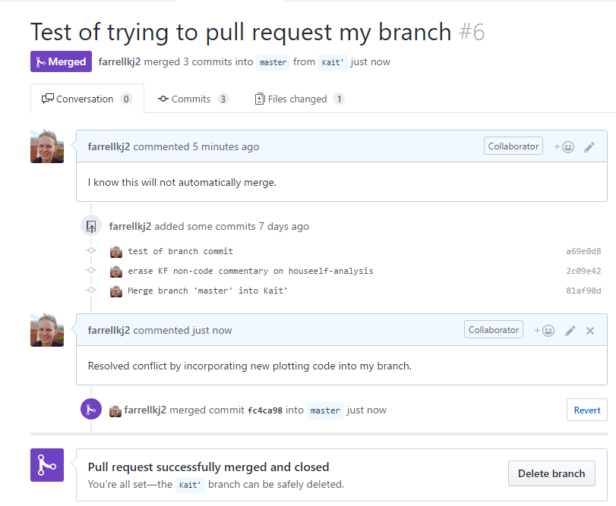
Once your branch is merged, it can be deleted
Delete branch if you’re done working on the ‘feature’ your made your branch to work on
(You can restore your branch later on if you want)
OR NOT!
If you want to keep working on your branch, make sure you use the usual workflow in RStudio → PULL the updates to your branch via RStudio

Slide 9
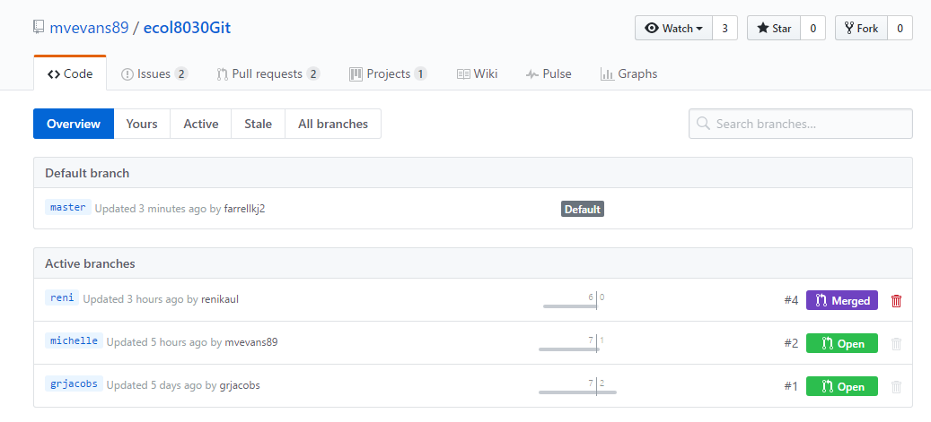
Climb around in the branches (at your own risk!)
From here, we can see that there are 2 open branches, which means they have not reconciled all changes through a pull request
Since reni is Merged, we know that she has completed a pull request (or someone else merged her branch for her!)

Slide 10
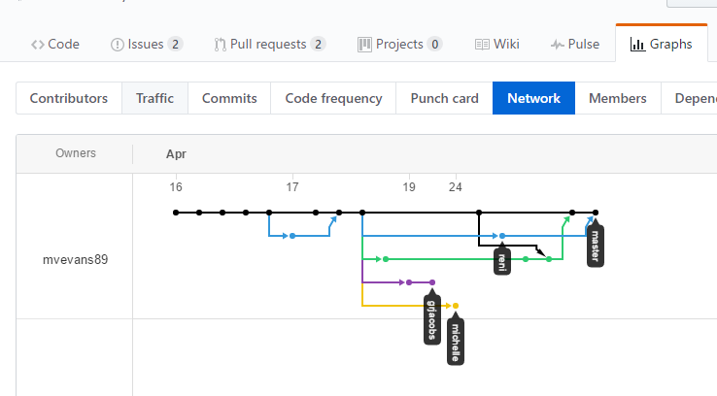
Visualize branches in your repository
As we just saw, reni and kait’ are merged back with the master
grjacobs and michelle are still out in the ether

Slide 11
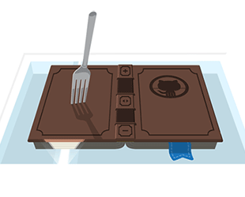
Stick a fork in it!
Common if you are wanting to contribute to a ‘3rd party’ project (i.e., not a direct collaboration)
Create a fork → clone your repo → work and commit to your fork
If you think your code has developed something that would be great to share with the larger community, you can merge your fork back
Sharing is caring

Slide 12
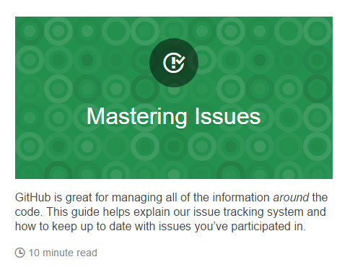
Take advantage of GitHub Guides
https://guides.github.com/
Relatively user friendly
Gives you an idea of how long it will take

